Slide 1
Mapping poverty using call detail records and remote sensing data
“Where you live should not determine whether you live, or whether you die.” -Bono
DAP DEEP DIVES | 12th Feb 2024

Slide 2
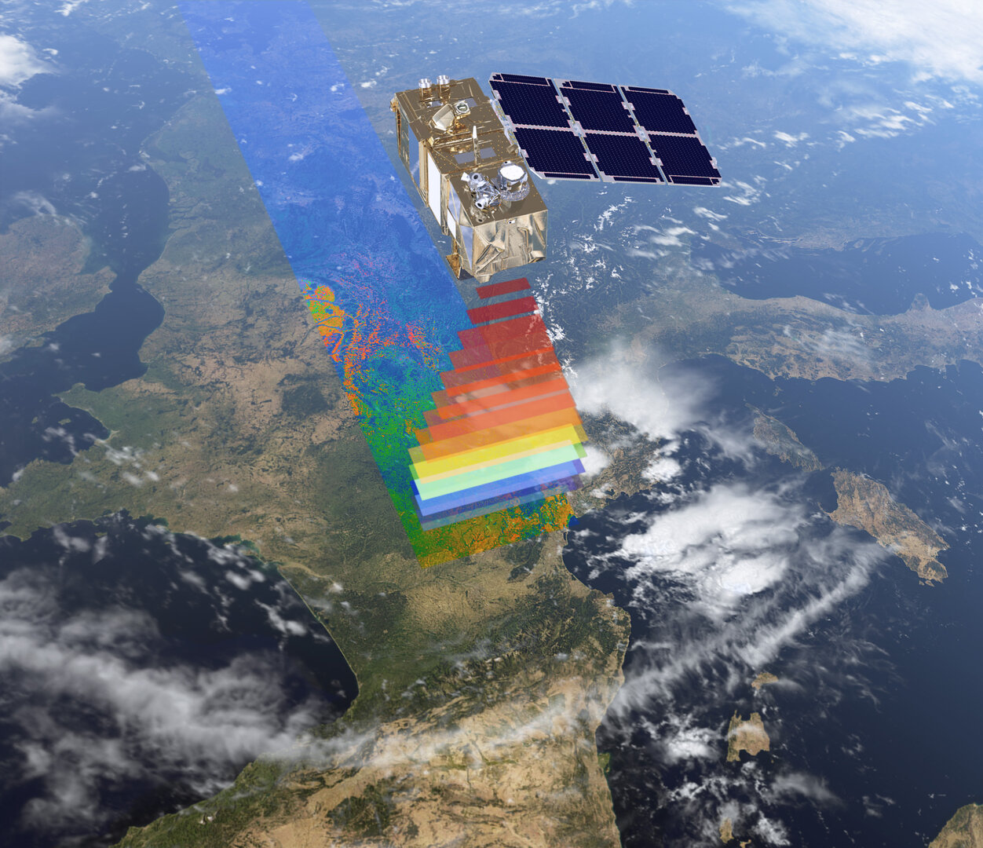
Chapters
Introduction.
Materials and Methods.
Our Approach and Goals
Regression Modelling.
Results.
Discussion.

Slide 3
Introduction
Poverty problems
What makes an ideal poverty map
Why past efforts were less than ideal
What we are doing instead

Slide 4
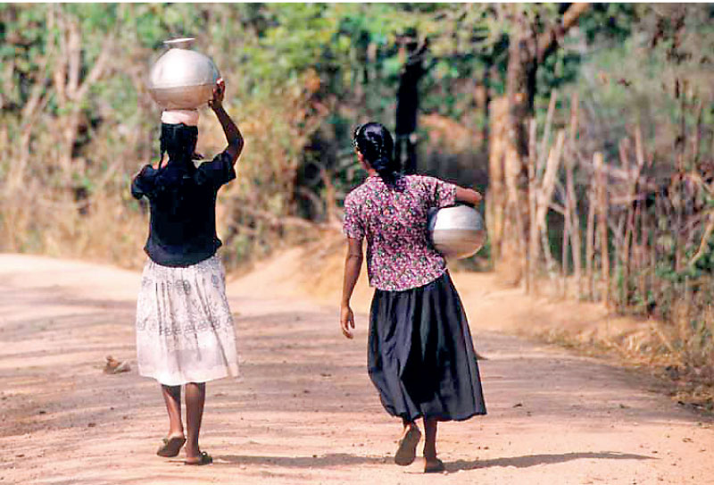
Poverty problems
Major determinant of adverse health outcomes including child mortality , and contributes to population growth , societal instability and conflict.
Insufficient access to healthcare, proper nutrition, and sanitation, stemming from poverty, gives rise to these health challenges.
Economic inequalities, uneven resource distribution, and limited opportunities fuel widespread poverty issues.

Slide 5

Therefore, In 2015, when the United Nations envisioned the world in 2030, eradicating poverty was listed the first among its 17 Sustainable Development Goals (https://sdgs.un.org/goals) that the world should work towards.
But to do so, we fist need to know where poverty lies &
How it differs from one place to another in order
To allocate resources in accordance with local needs.
Notes:
Eradicating poverty requires strategies that address the root causes of deprivation and inequality.
Interventions across domains: Education / Healthcare / Infrastructure Development / Employment Generation
Policy Frameworks: Policy coherence / Resource mobilization / Legal and Institutional reforms / Direct international Organizations / civil society

Slide 6
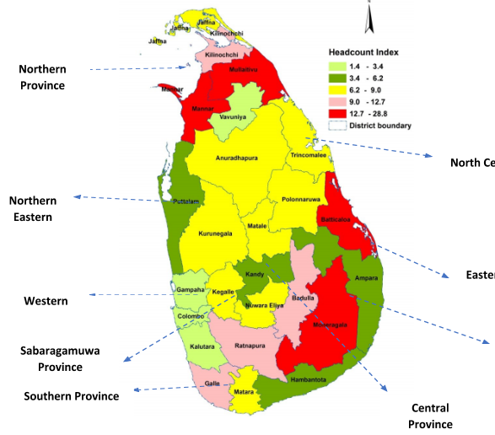
What makes an ideal poverty map
An ideal poverty map would be both
(1) spatially granular and
(2) temporally up-to-date.
It other words, it captures the slightest nuances
across both time and space — nuances that are
easy to ignore but meaningful and necessary for
making informed and tailored poverty alleviation
policies.
Notes:
Importance of Poverty Maps:
Poverty maps serve as invaluable tools in the planning and implementation of poverty eradication strategies by:
Targeting Resources: Identifying areas and populations most in need allows policymakers and development practitioners to allocate resources efficiently and effectively.
Monitoring Progress: Tracking changes in poverty levels over time enables stakeholders to evaluate the impact of interventions, adjust strategies, and measure progress towards poverty reduction goals.
Informing Decision-Making: Providing spatially disaggregated data on poverty indicators facilitates evidence-based decision-making, enabling policymakers to tailor interventions to specific contexts and populations.
Advocating for Change: Raising awareness about the spatial distribution and prevalence of poverty through maps can mobilize political will, galvanize public support, and advocate for policy reforms aimed at addressing underlying structural inequalities.
Poverty maps are powerful tools used to visualize and analyze the spatial distribution of poverty within a geographic area. They provide a visual representation of poverty levels, allowing policymakers, researchers, and development practitioners to identify areas of high need and target interventions more effectively.
The maps often display poverty indicators such as income levels, access to basic services, housing conditions, and socio-economic vulnerabilities. By overlaying these indicators onto geographic boundaries, such as administrative units or, GIS data poverty maps reveal spatial patterns and disparities in poverty, highlighting areas with the greatest need for intervention.

Slide 7

Why past efforts were less than ideal
High-quality data — that is, both granular and updated — are hard to find. This is because:
Census — the most detailed and granular source of data: collected typically every ten years, it collected directly addresses income or consumption — indicators that have most often been used to capturing poverty in past research.
Survey of household income and expenditure takes place every three years, data are only available on a much less granular level.
Notes:
Historically, however, this has been no easy task. High-quality poverty maps that are both granular and up-to-date are hard to produce. This can be largely attributed to the difficulty of collecting detailed data on poverty how — and when — data on poverty are collected.
Administrated typically every ten years, censuses remain the most detailed and granular source of statistical knowledge on a country, but in most developing countries, information on income and expenditure — indicators strongly suggestive of the presence of poverty — are rarely collected (## Tarozzi & Deaton 2009).
Sri Lanka is no exception. The Sri Lankan census (called Census of Population and Housing, or CPH, last collected in 2012) makes available statistics on arguably the most granular level possible for each of the 14,022 Grama Niladhari Divisions (GNDs) in Sri Lanka. Nevertheless, none of the 109 variables it collected directly addresses income or consumption — indicators that have most often been used to capturing poverty in past research.
In its stead, the Sri Lankan government relies on a different source to understand the spatial distribution of poverty (albeit on a much less granular level): the Household Income and Expenditure Survey (HIES), which takes place every three years, a much shorter cycle than the decennial census. It collects information on the economic wellbeing of nationally representative households, such as their source of income and expenditure structure. It then calculates and presents the percentage of population falling below the official poverty line in a given district (known as Headcount Index, or HCI) as well as a common measure of the severity of poverty known as Poverty Gap Index.
For those familiar with administrative geography in Sri Lanka, however, the way HIES aggregates and makes available data lends itself a fatal shortcoming (despite the comprehensiveness of its statistics). While the survey is conducted at a relatively granular level of District Secretariat Divisions (DSDs or DS Divisions) — of which there are 331 in Sri Lanka — the survey’s sample size is not large enough to accurately estimate statistics below the level of Districts, a higher-level administrative unit of which there are only 25 across the island (## DCS 2015 Report). In other words, by relying on this survey itself, we cannot possibly gain any concrete knowledge of the economic disparity that expectedly and demonstrably exists within each District.
Updating census data takes a long time, making it difficult to quickly understand and respond to changes in poverty.
Asset-based indicators and Consumption based indicators that census relies on, may not accurately represent household economic conditions.
Also, conducting a census or household survey is both expensive and time-consuming.

Slide 8
What we are doing instead
We now have access to novel sources of data derived from remote sensing and geographic information systems (RS data) as well as mobile operator call detail records (CDR data).
Taken together, they offer us a rare look into the ever-changing spatial pattern of socio-economic wellbeing on a much more granular and up-to-date level, beyond the limits of traditional sources like censuses and surveys.
RS data capture the physical landscape of a place such as the presence of agricultural land, the compactness of buildings, the connectivity of roads, among many others
Similarly, monthly mobile credit usage and the prevalence of mobile phone use in an area reflect household access to financial resources. Additionally, mobile phone movements and calling network structures may be correlated with remittance flows and economic opportunities.

Slide 9
Materials and Methods
CDR and RS data
Poverty Data
Spatial Scale and Data Processing

Slide 10
CDR and RS Data
Mobile Call Detail Records (CDRs) were gathered from two major mobile network operators in Sri Lanka for the year 2013.
.
Features derived from CDR data
Feature category | Individual feature description
Phone usage | Call count, average call duration, nighttime call count, incoming call count, avg nighttime call duration, avg incoming call duration, avg outgoing call duration
Location/mobility | Radius of gyration, home location
Social Network | Spatial entropy, avg call count per contact
Handset type | Smart/feature/basic phone

Slide 11
CDR and RS Data
Features derived from GIS & Remote Sensing Data
Simultaneously, we gathered and processed 25 raster and vector datasets covering the entire Sri Lanka at the Grama Niladhari (GN) division level for Remote Sensing (RS) data.
Feature Category | Feature Description
Accessibility | Accessibility to populated places with more than 50k people
Population | Population count, Population density
Climate | Mean aridity index, Mean annual precipitation, Mean annual temperature,Average annual potential evapotranspiration [mm]
Night-time lights | VIIRS satellite night-time lights intensity
Elevation
Vegetation | Vegetation Index
Distance | Distance to roads, Distance to waterways
Urban/rural | MODIS satellite -based global urban extent
Protected area | Protected areas
Land cover | European Space Agency land cover map values
Demographic | Pregnancies, Births

Slide 12
Poverty Data
Applied PCA techniques to 2012 census data at GN Division level, reducing 109 variables to 61.
Normalized and standardized variables for uniformity. Ran PCA, using the first principal component as the socio-economic index.
Multiplied PCA weights with standardized data. Summed each row to produce a socio-economic score for each GN Division.

Slide 13
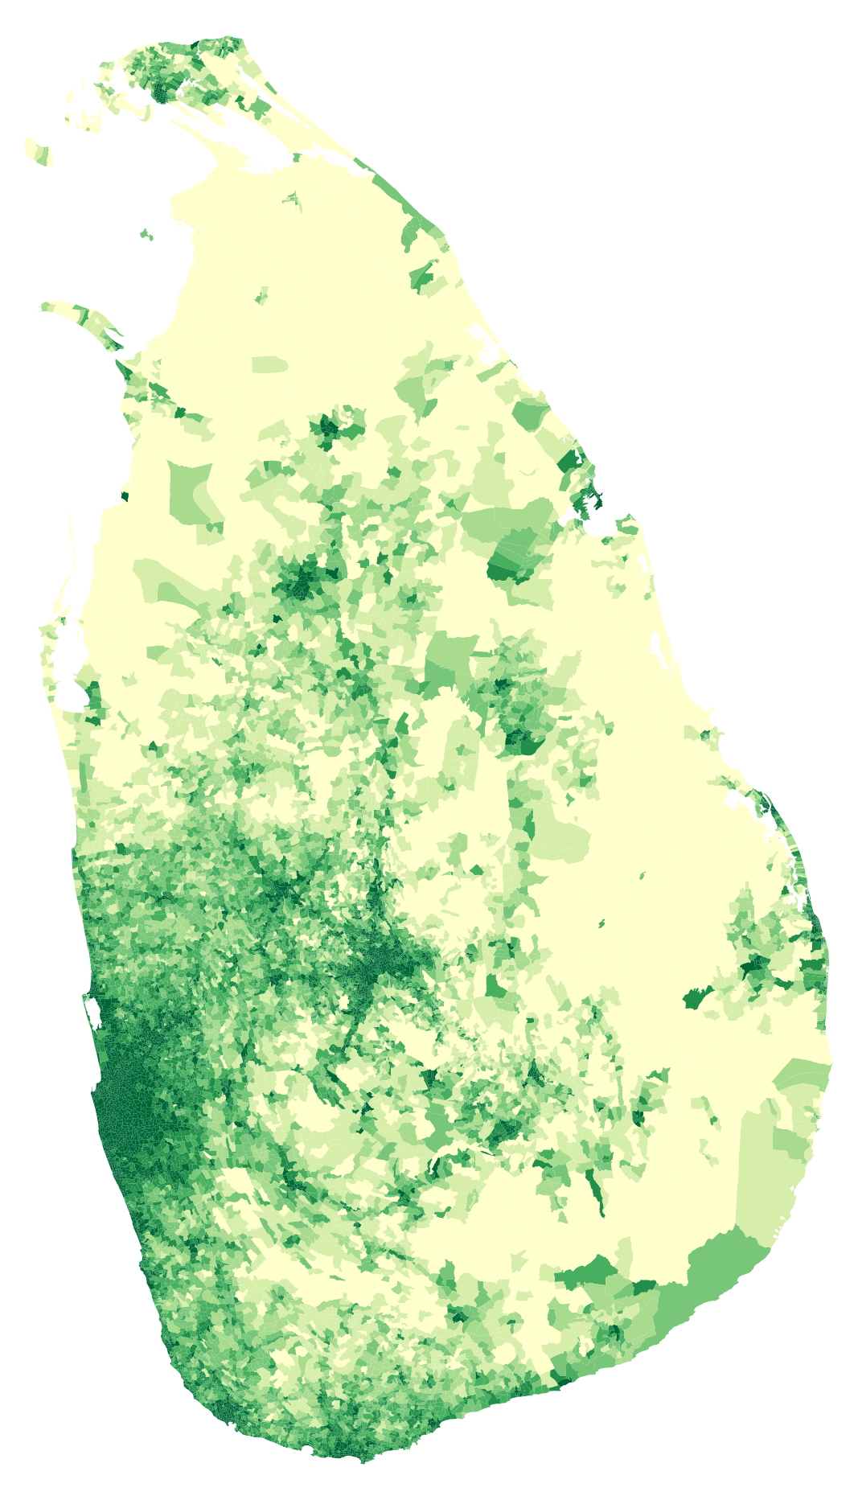
PCA Results
This is the PCA results derived from the 2012 data serve as a basis for extrapolating or predicting trends and patterns for the year 2013.

Slide 14
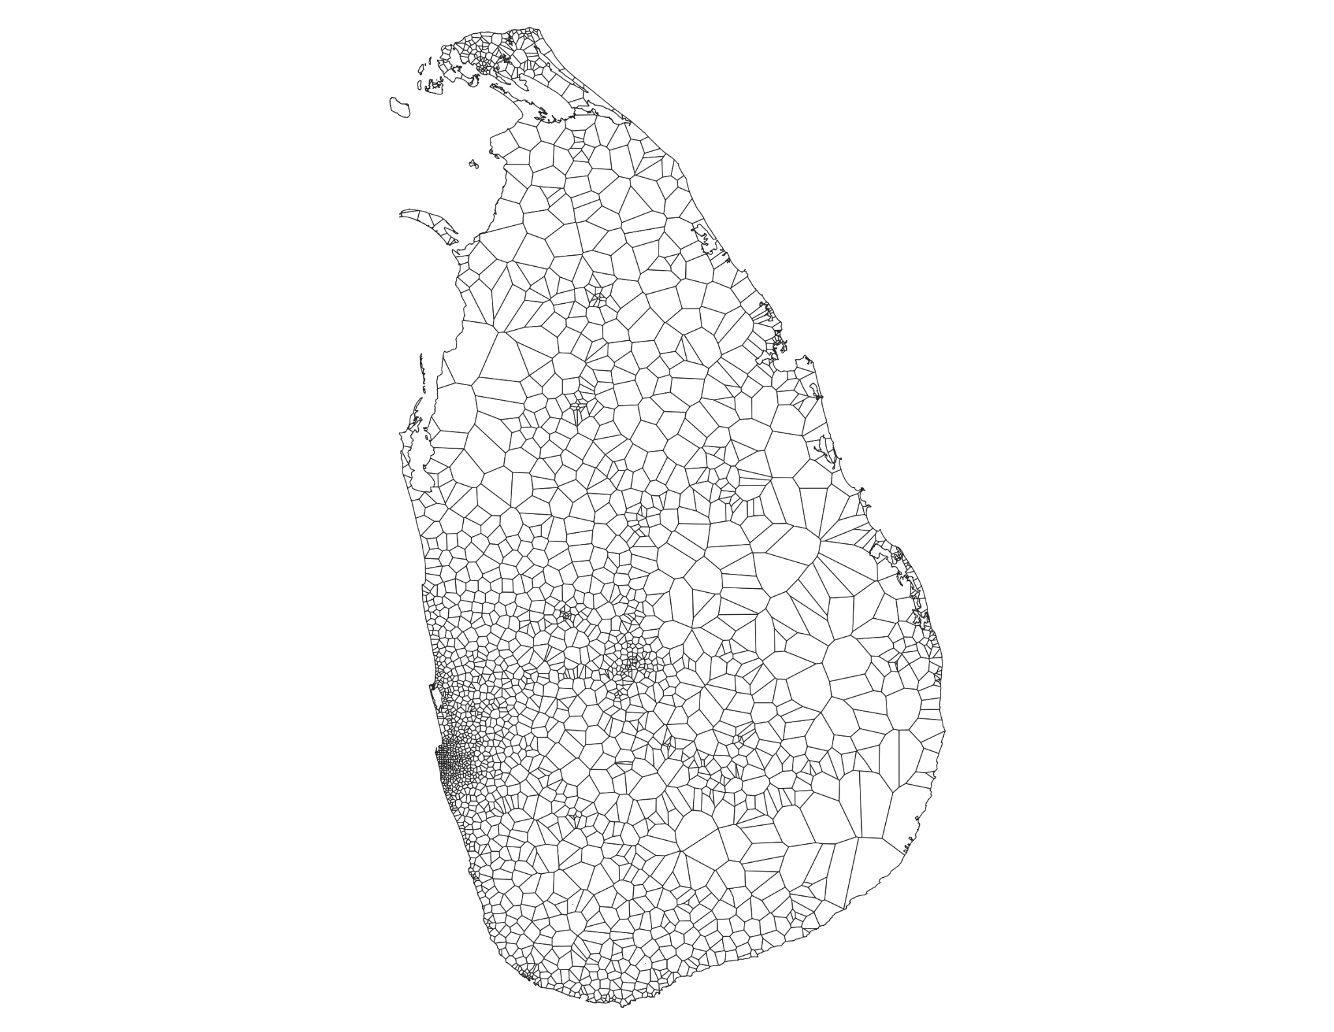
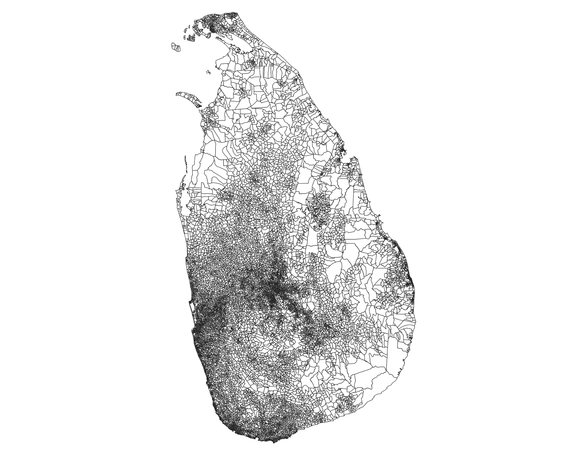
Spatial Scale and Data Processing
2306 Voronoi cells
14022 GNs

Slide 15
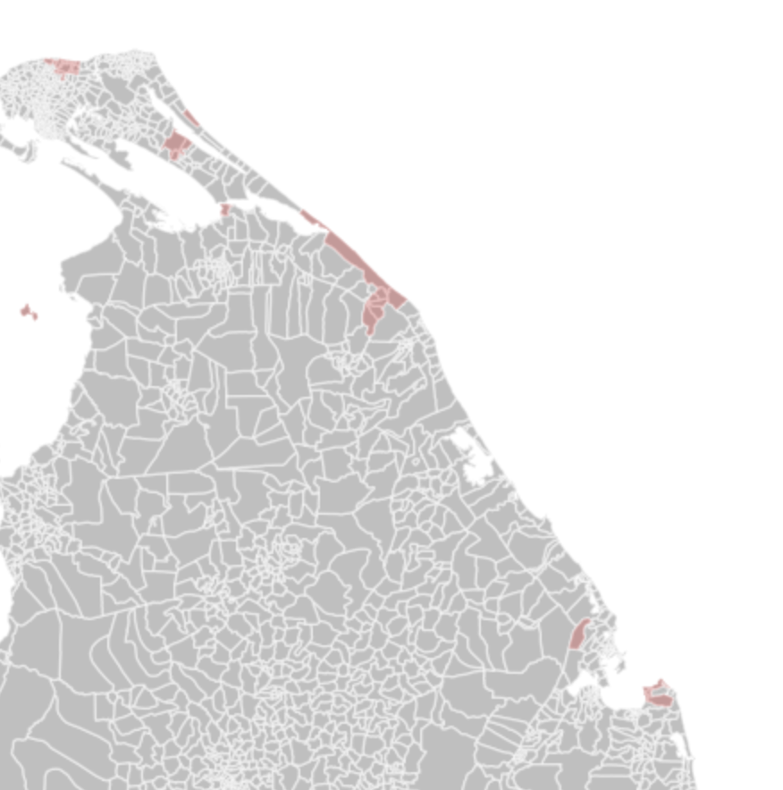
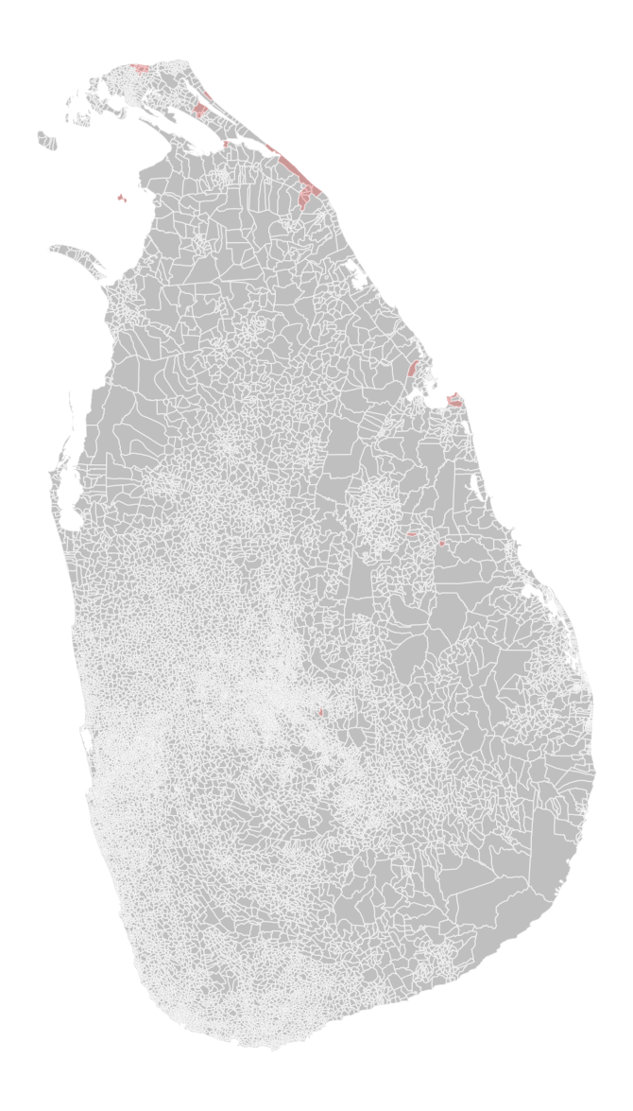
Spatial Scale and Data Processing
2. We identified that there are 37 Grama Niladhari divisions with zero population at the time of the data collection.

Slide 16
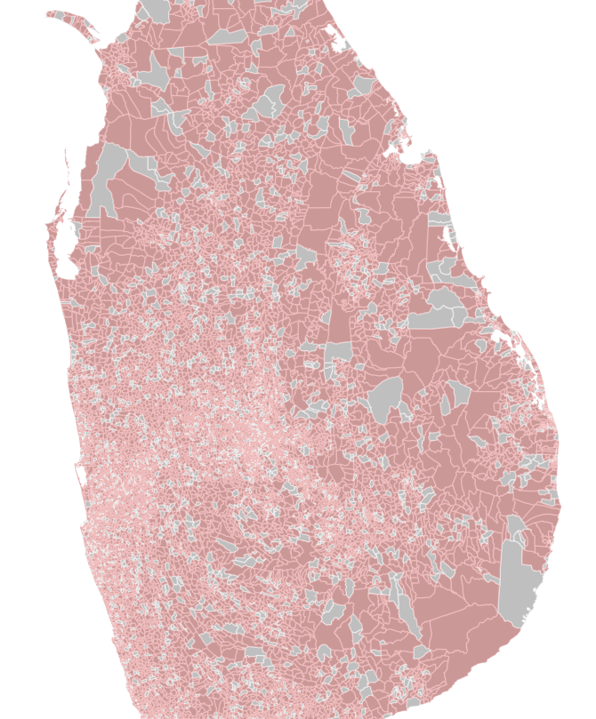
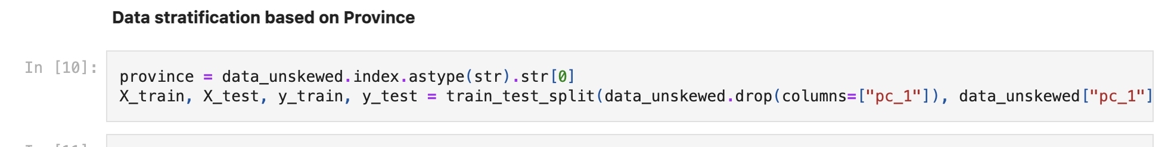
Spatial Scale and Data Processing
3. In preparing the training data, dataset was stratified based on province

Slide 17
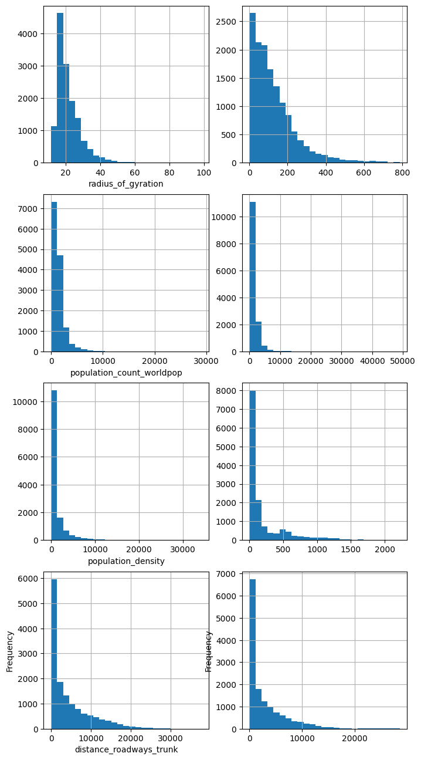
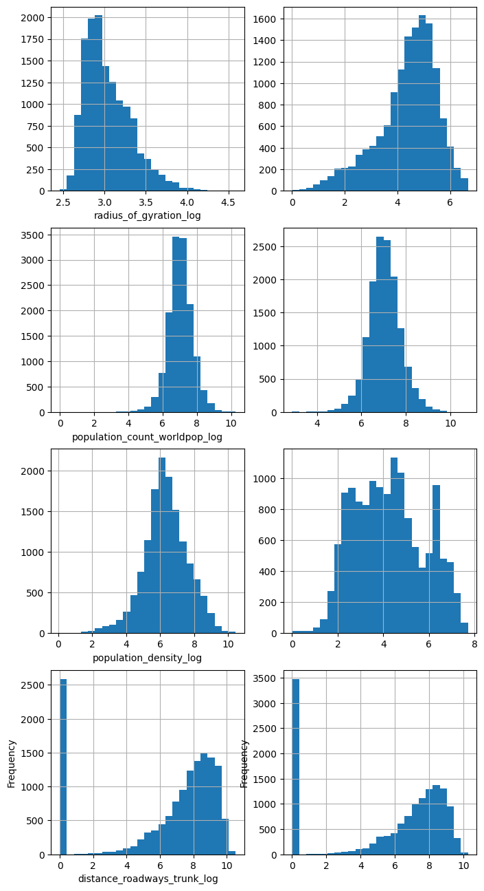
Spatial Scale and Data Processing
4. Log transformation of skewed variables

Slide 18
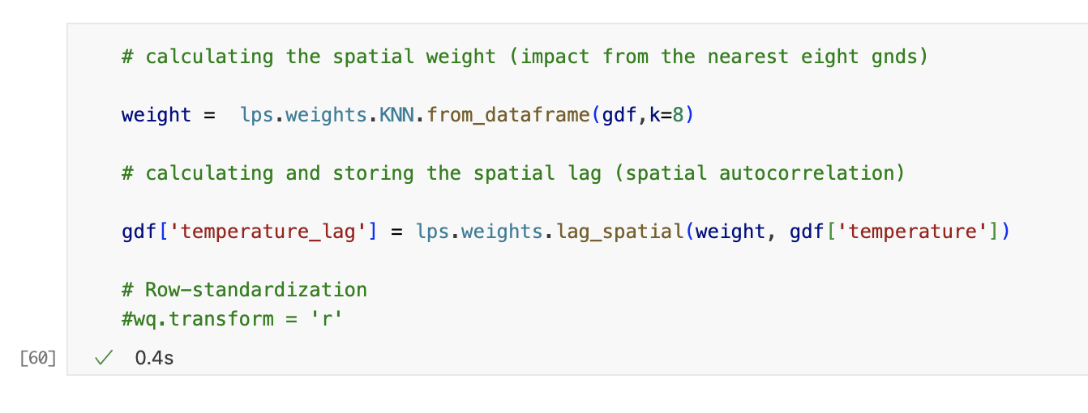
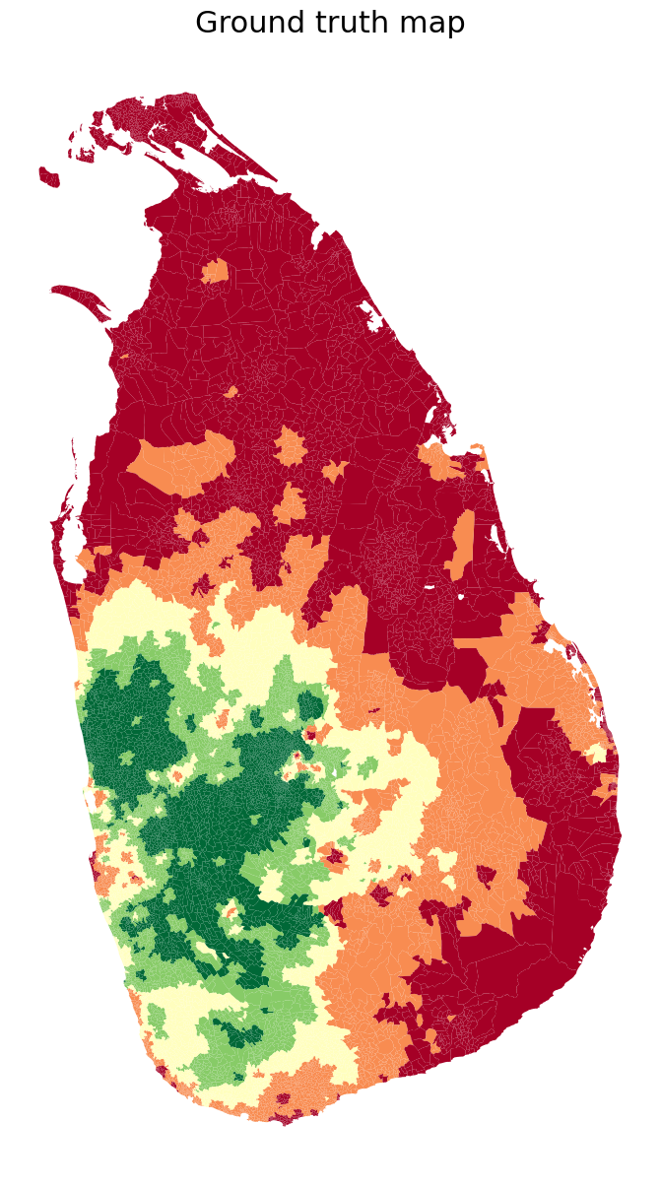
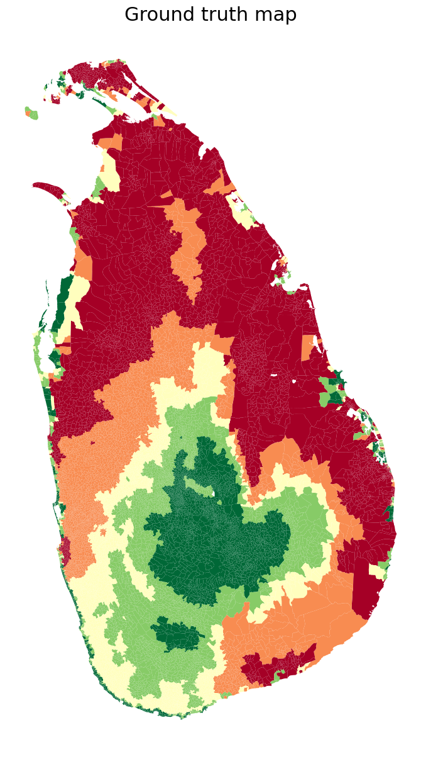
Spatial Scale and Data Processing
4. Spatial weights were assigned to data using nearest neighbor method
Radious of gyration Lag
Temperature Lag

Slide 19
Our Approach and Goals
Can CDR and RS data be used to reliably estimate poverty in Sri Lanka?
Are these estimates more accurate in urban areas, rural areas or at the national level?

Slide 20
Goal 01: Can CDR and RS data be used to reliably estimate poverty in Sri Lanka?
Spatial Regression Modeling
Frequentist
Bayesian
Spatial Error Model (SEM)
Spatial Lag Model (SLX)
Spatial Durbin Error Model (SDEM)
Ordinary Least Squares
Basic Model
INLA Model

Slide 21
Frequentist Models
Ordinary Least Squares (OLS)
Spatial Error Model (SEM)
Spatial Lag Model (SLX)
Spatial Durbin Error Model (SDEM)

Slide 22
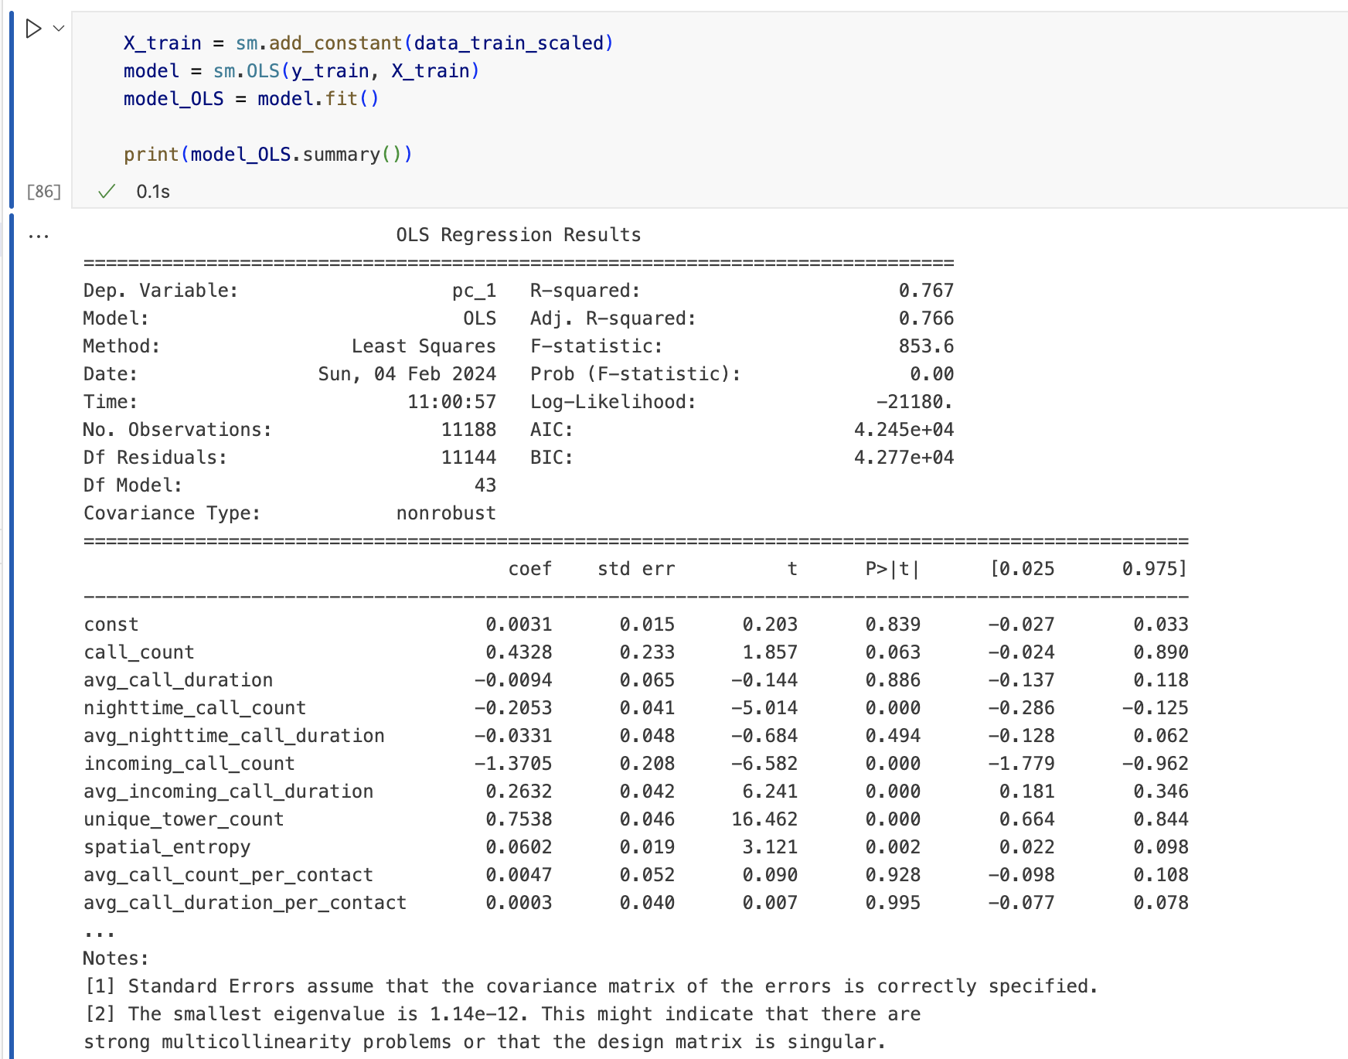
Frequentist Models
Model Outputs – Ordinary Least Squares (OLS)
Notes:
.

Slide 23
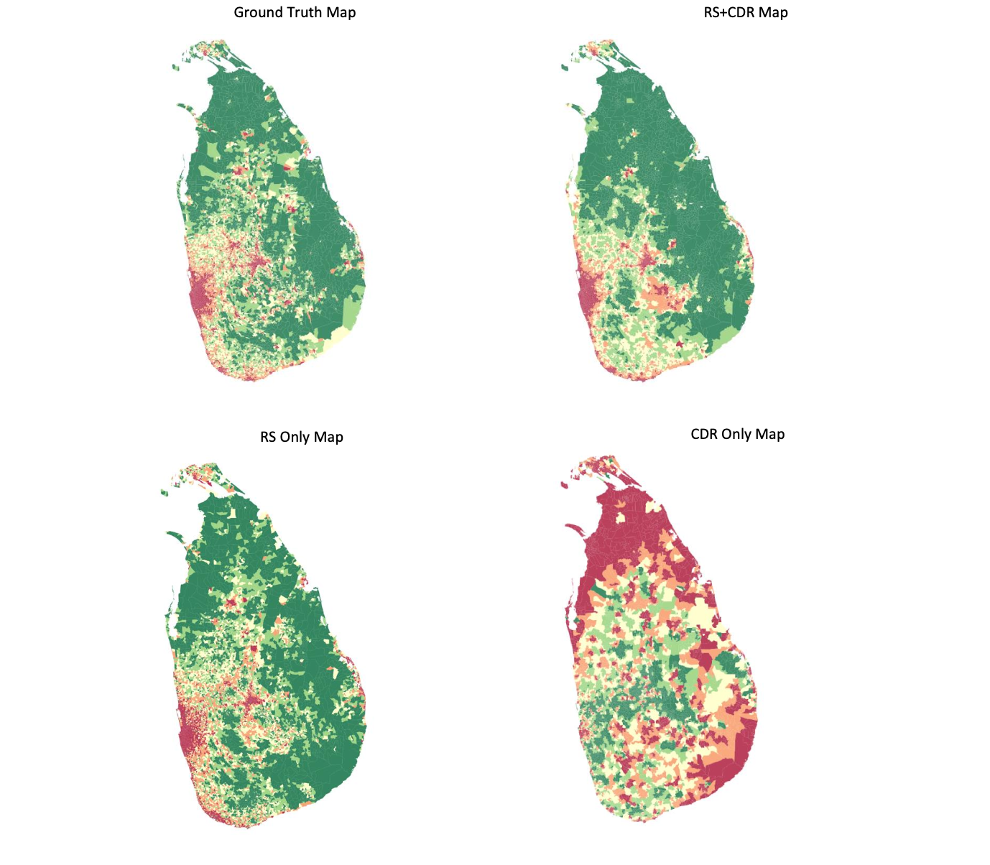
Frequentist Models
Visual Comparison of Model Outputs - SEM

Slide 24
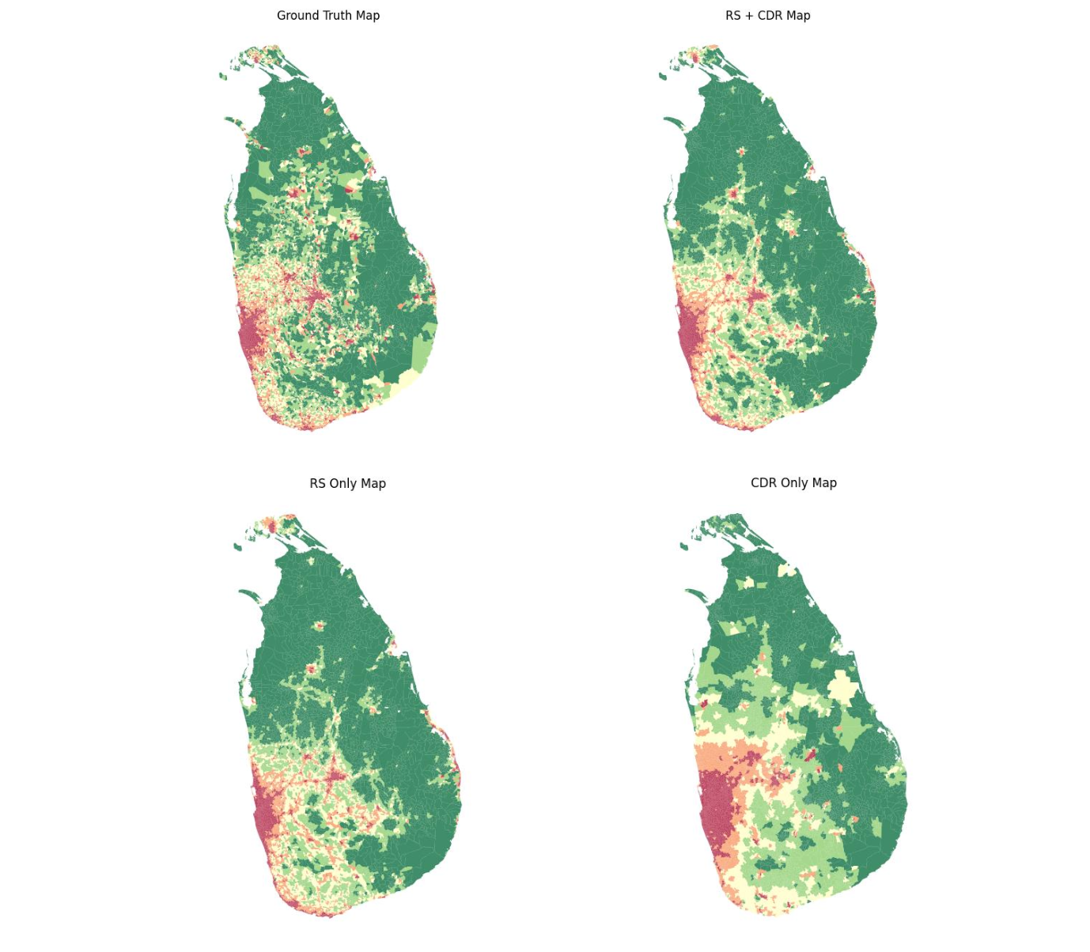
Frequentist Models
Visual Comparison of Model Outputs - SDEM

Slide 25
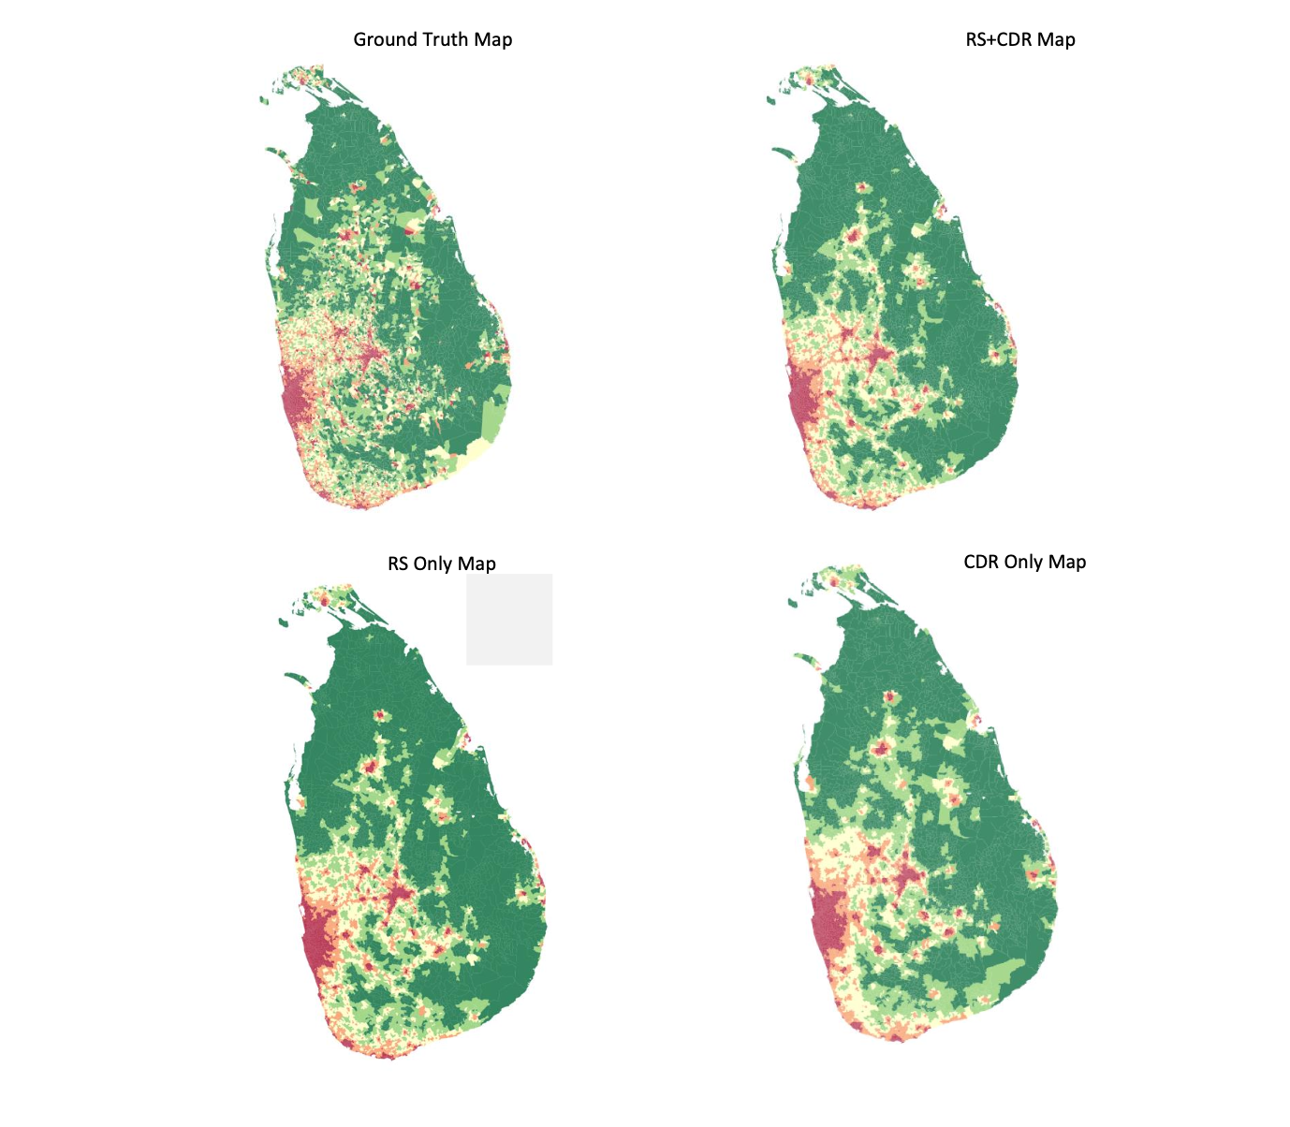
Frequentist Models
Visual Comparison of Model Outputs - SLX

Slide 26
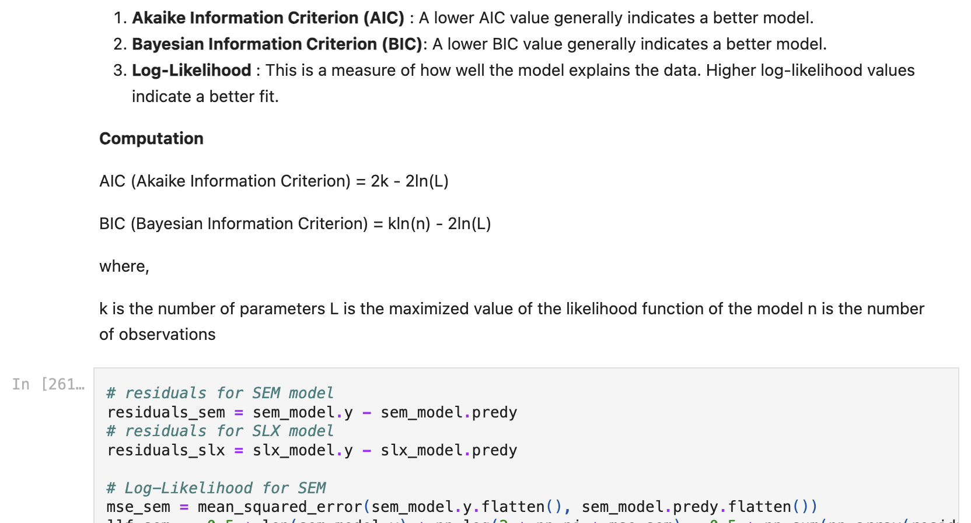
Frequentist Models
Model Comparison – SEM vs SLX vs SDEM

Slide 27
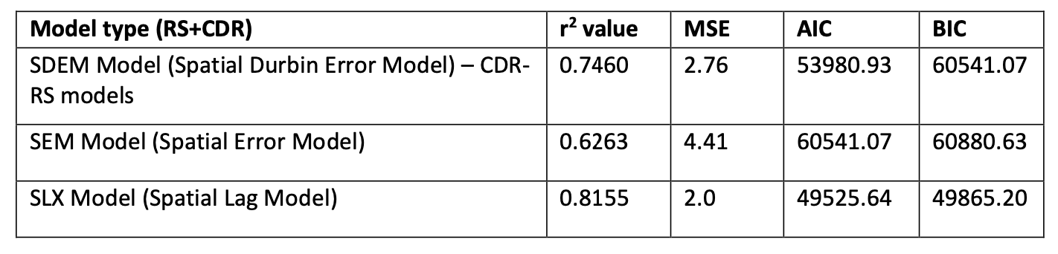
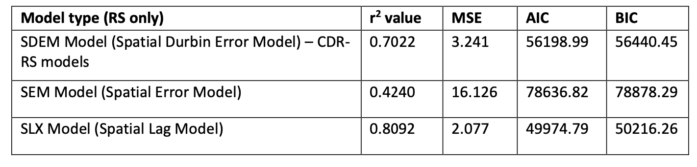
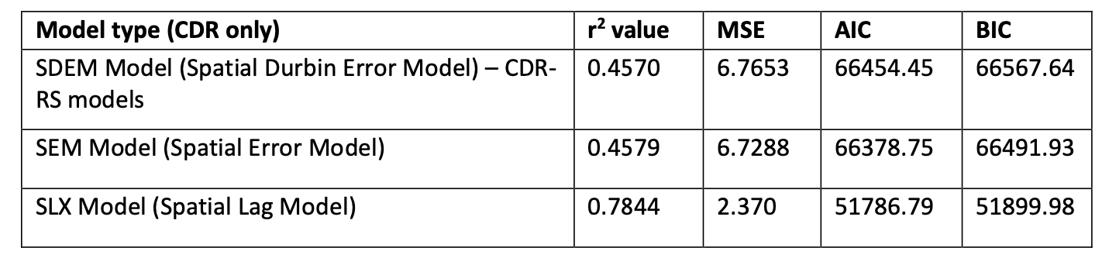
Frequentist Models
Model Comparison – SEM vs SLX vs SDEM

Slide 28
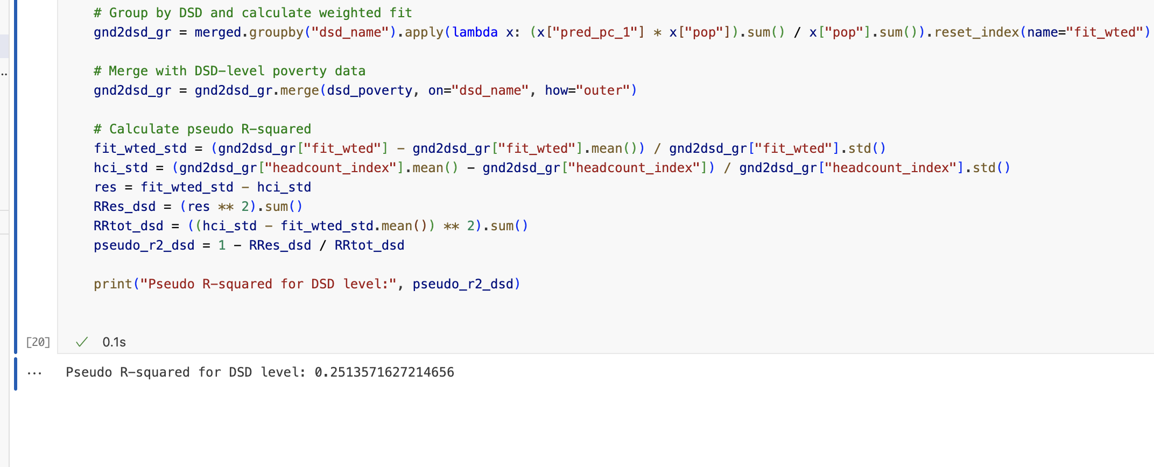
Frequentist Models
SDEM Evaluation: Validating the Model against DSD-level Poverty Headcount Index

Slide 29
Bayesian Models
Basic Model
Integrated Nested Laplace Approximations (INLA)

Slide 30
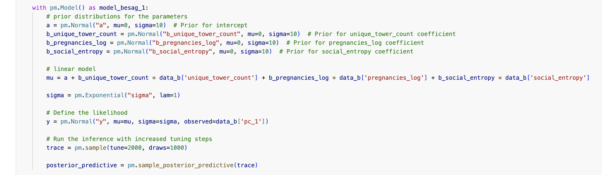
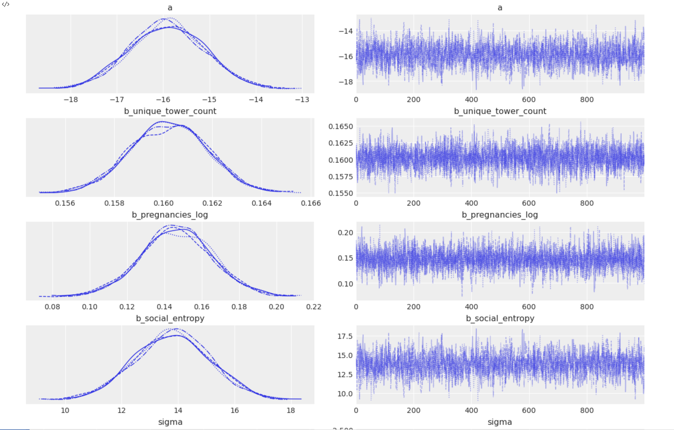
Bayesian Models
Bayesian INLA Model - fit a preliminary model with a few predictors

Slide 31
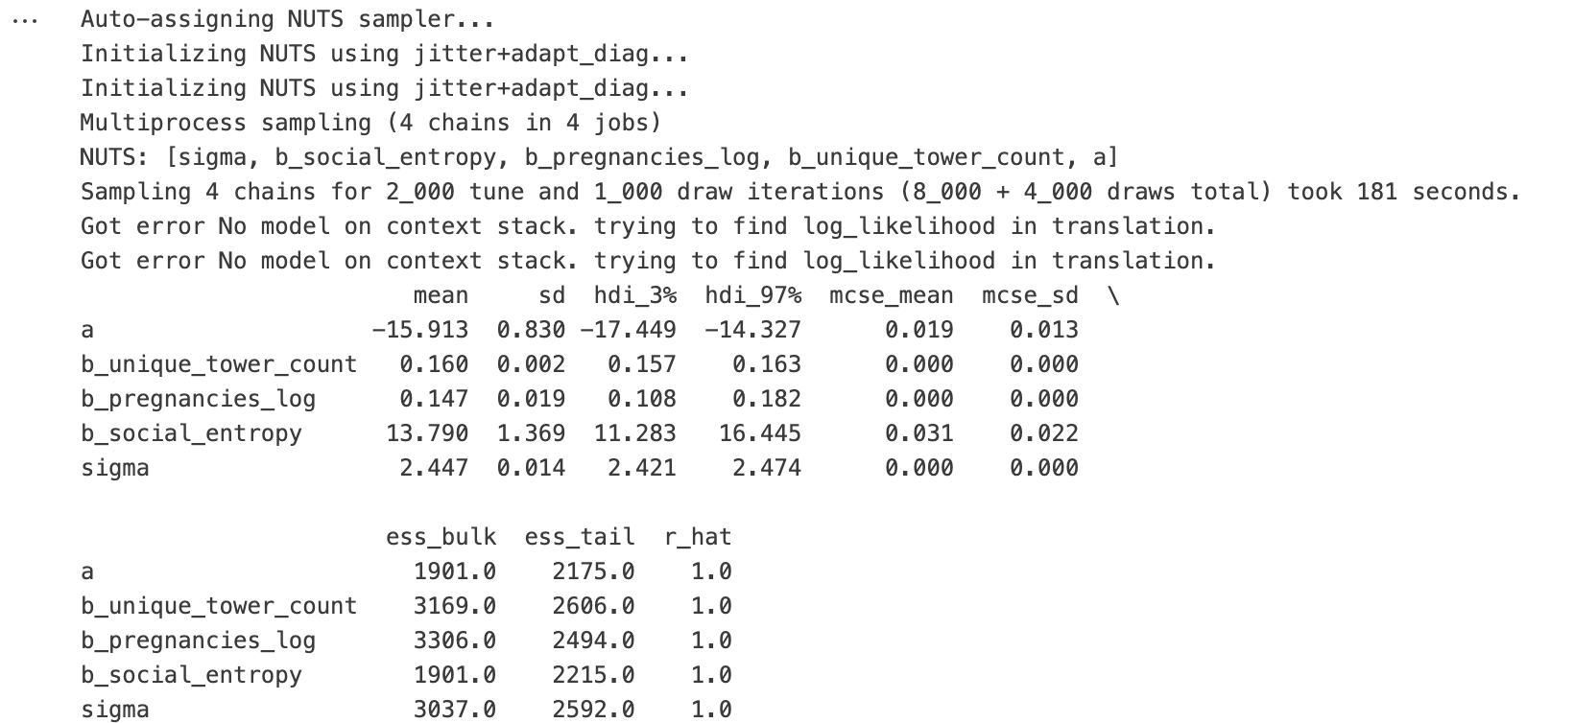
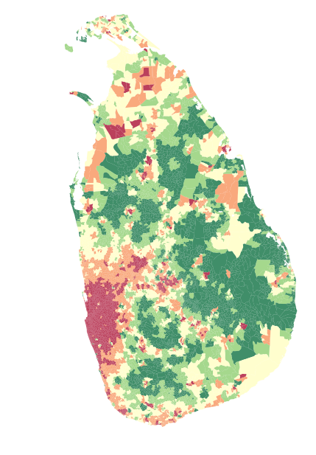
Bayesian Models
Bayesian INLA Model - fit a preliminary model with a few predictors

Slide 32
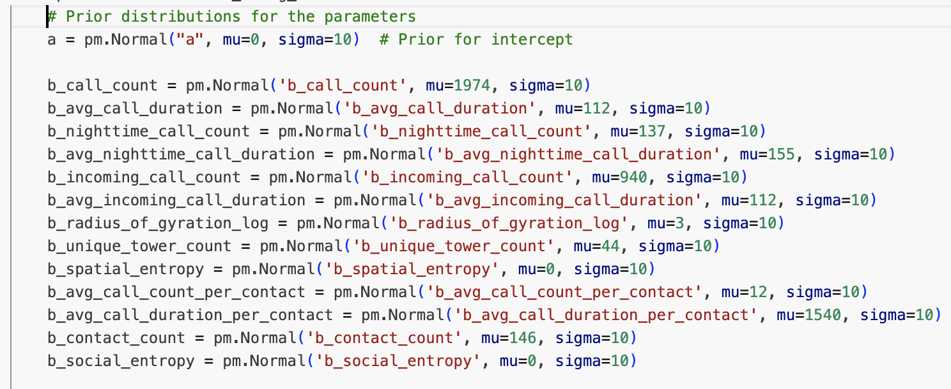
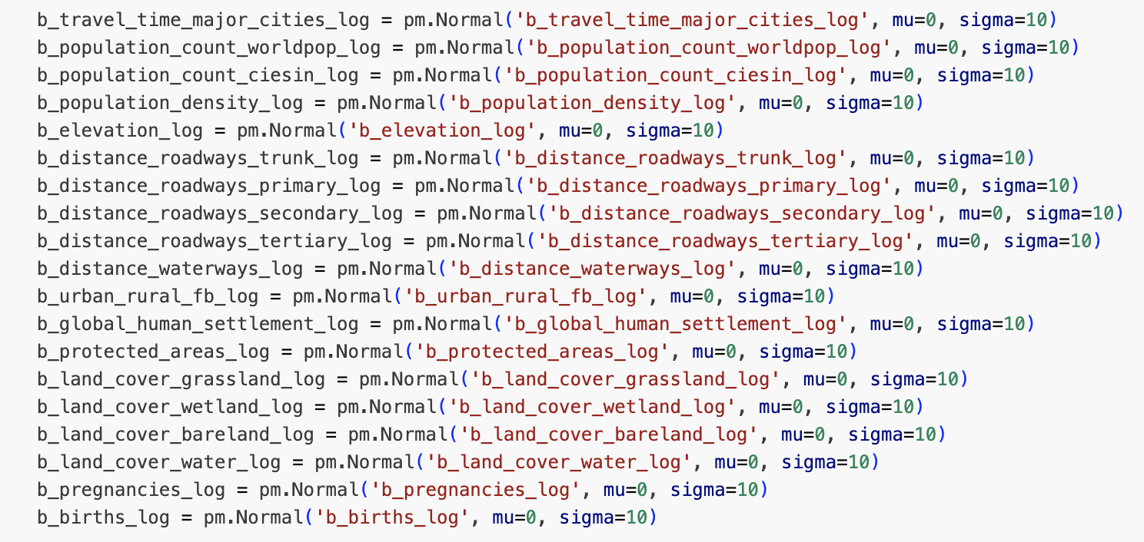
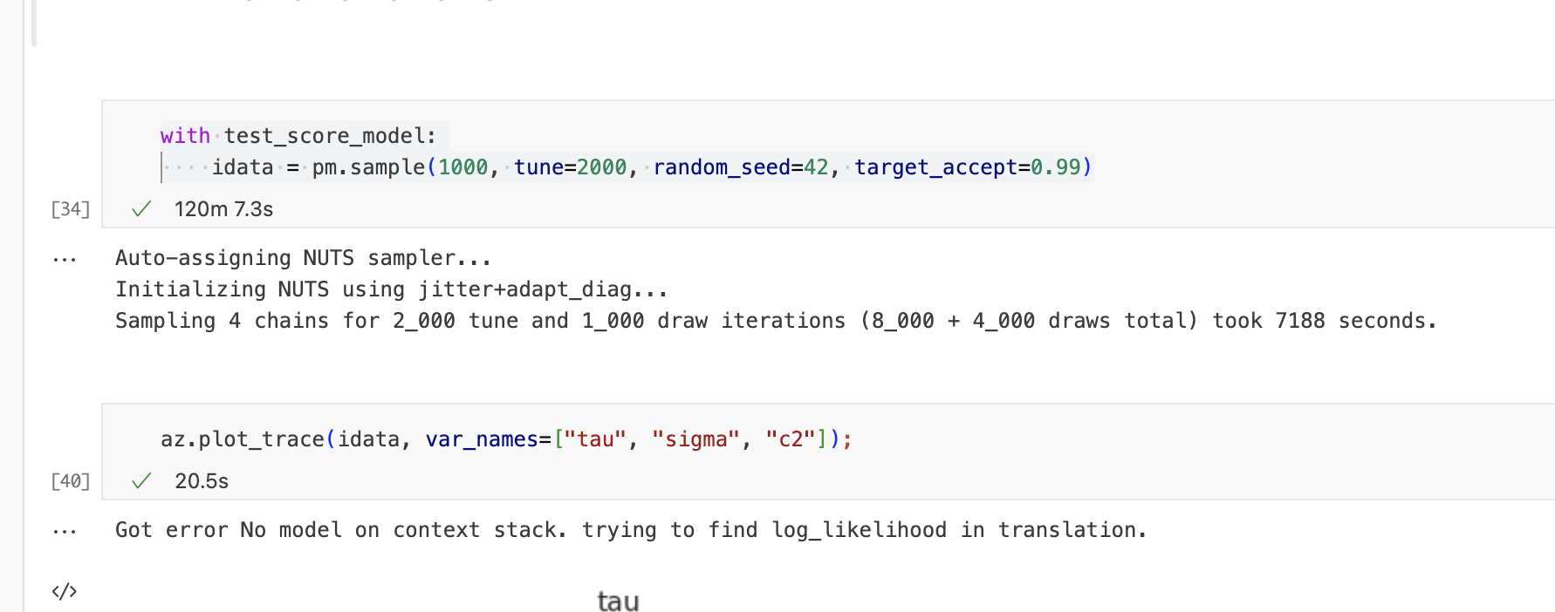
Bayesian Models
Bayesian INLA Model - fit a full model with all the covariates available

Slide 33
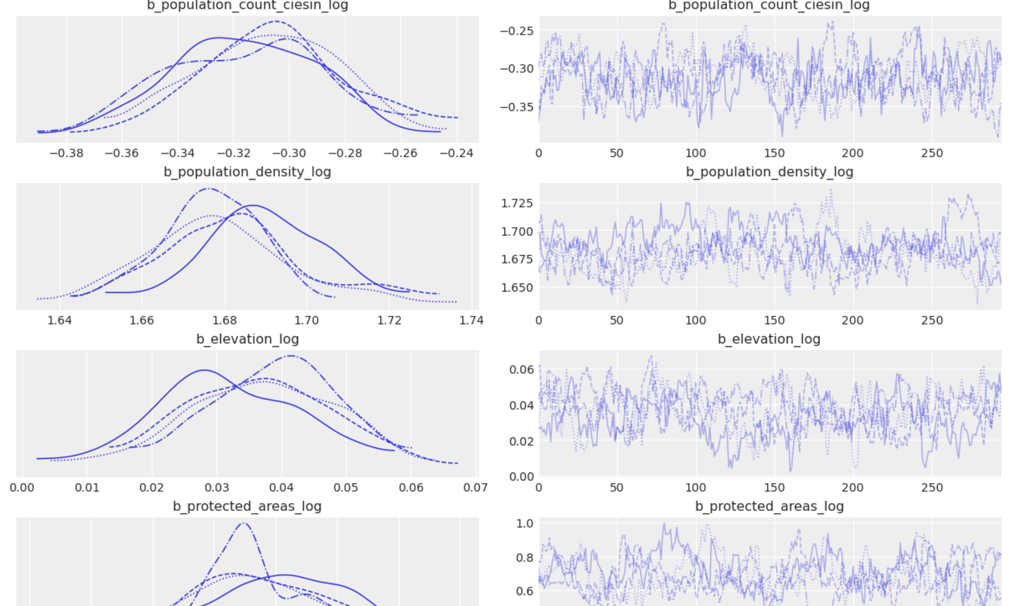
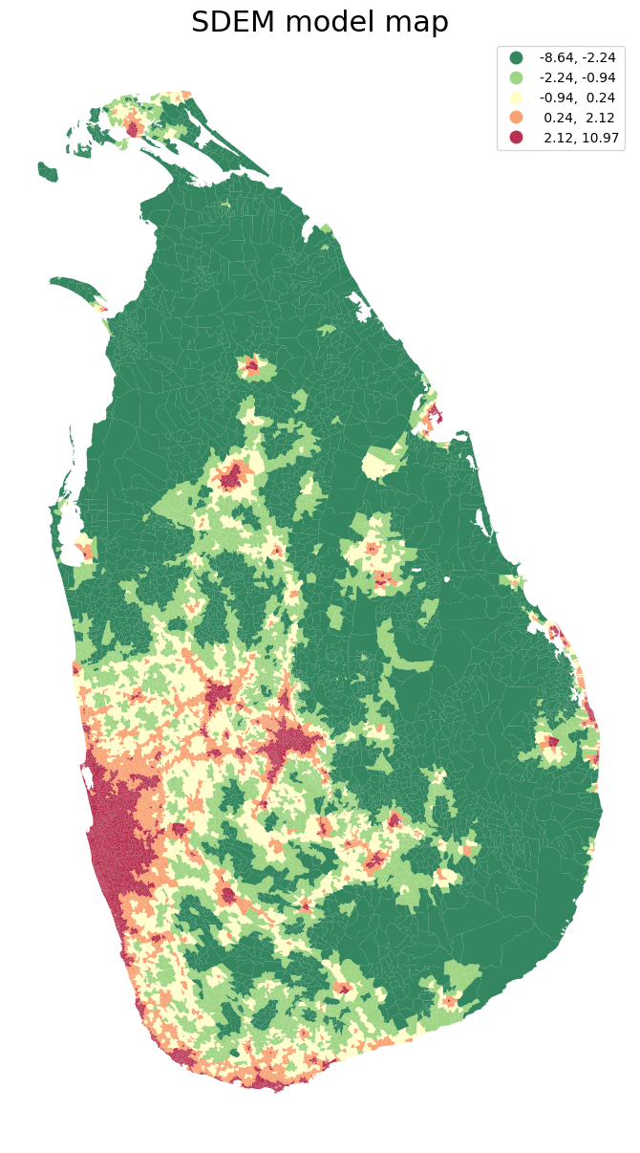
Bayesian Models
Bayesian INLA Model - fit a full model with all the covariates available

Slide 34
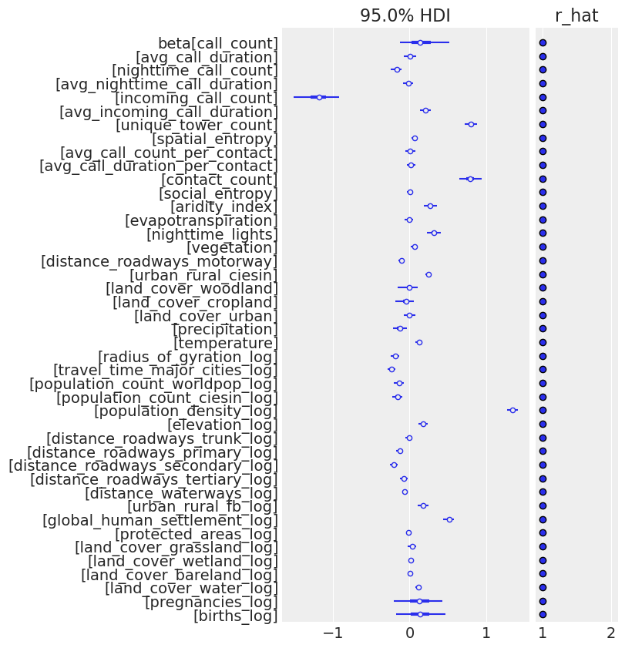
Bayesian Models
Bayesian INLA Model - fit a full model with all the covariates available

Slide 35
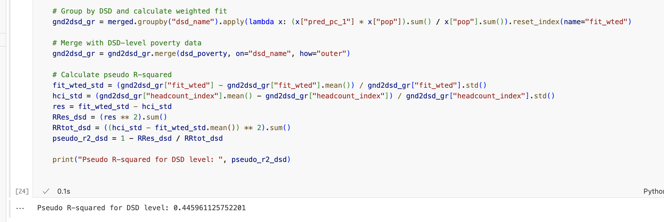
Bayesian Models
INLA Model Evaluation: Validating the Model against DSD-level Poverty Headcount Index

Slide 36
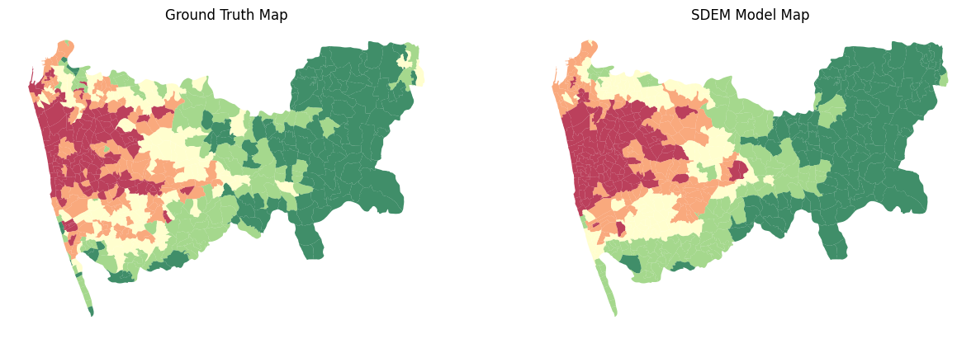
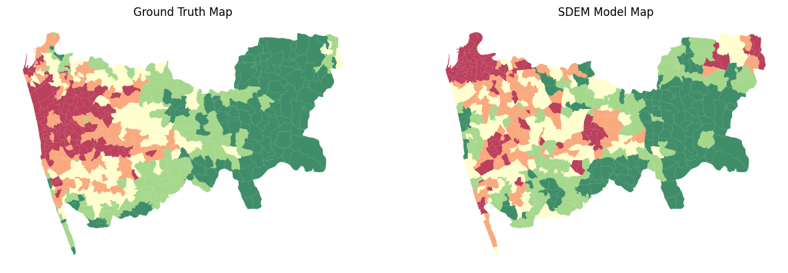
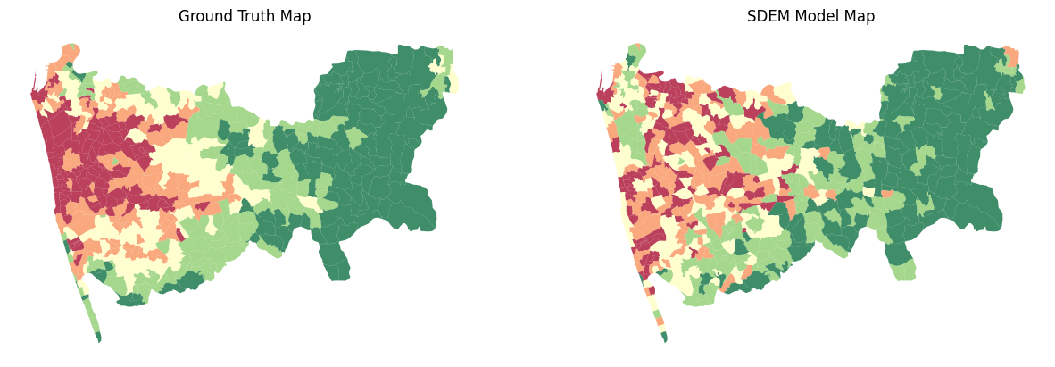
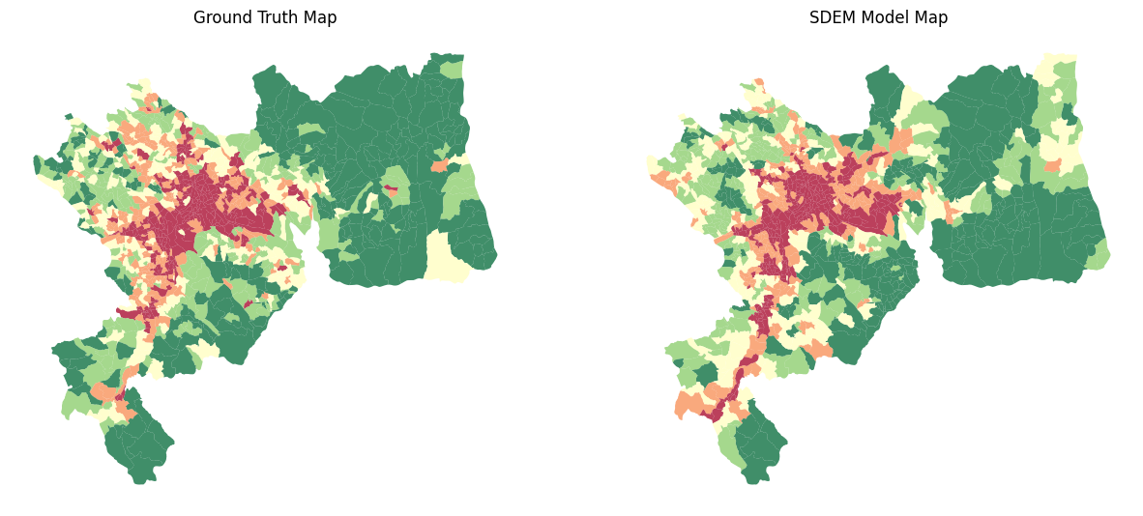
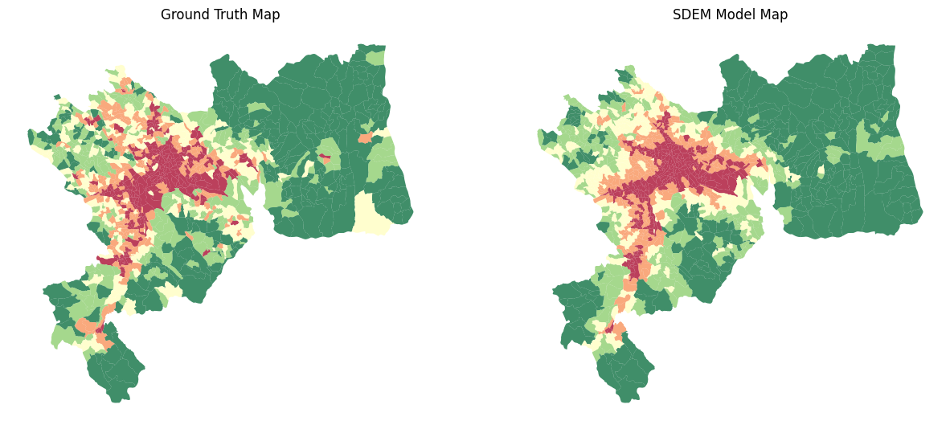
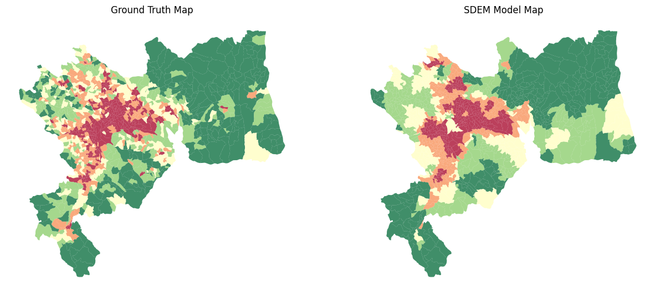
Goal 02: Are these estimates more accurate in urban areas, rural areas or at the national level?
Case Urban: Colombo
Ground Truth. CDR Only: 0.799 CDR + RS: 0.34 RS only: 0.64
Case Urban: Kandy
Ground Truth. CDR Only: 0.63 CDR + RS: 0.55 RS only: 0.74

Slide 37
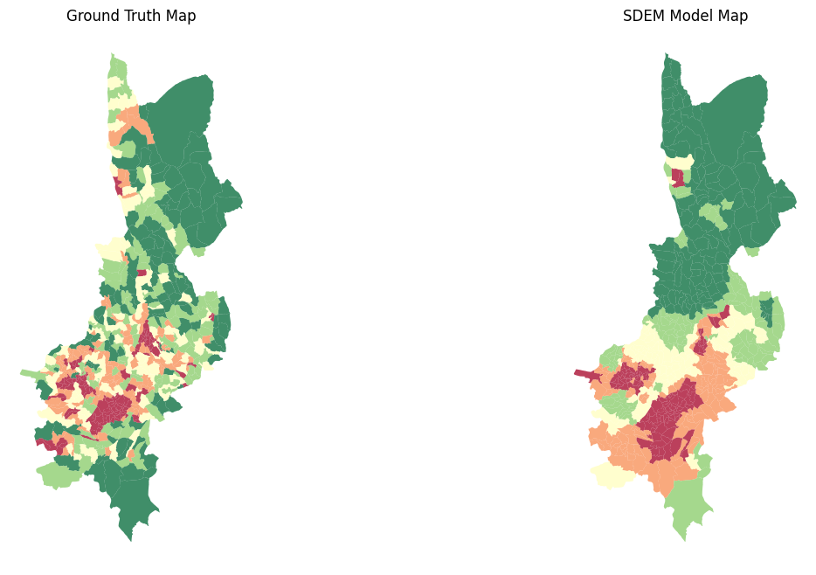
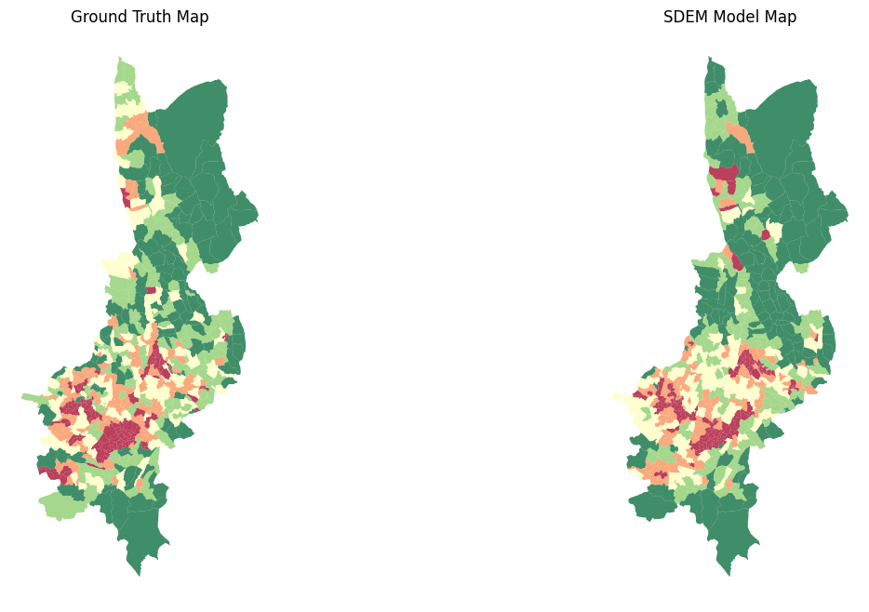
Goal 02: Are these estimates more accurate in urban areas, rural areas or at the national level?
Case rural: Badulla
Ground Truth. CDR Only: 0.27 CDR + RS: 0.66 RS only: 0.63

Slide 38
Discussion
Using CDRs and RS data within BGMs to produce accurate, high-resolution poverty maps in LMICs offers a way to complement census-based methods and provide more regular updates.
Regularly updated poverty estimates are necessary to enable subnational monitoring of the SDGs during intercensal years and are critical to ensure mobilization of resources to end poverty in all its dimensions as set out in SDG 1.
Poverty estimates are time sensitive and become obsolete when factors such as migration rates, infrastructure, and market integration change.
Furthermore, the methods presented here offer a workaround to estimating poverty with household survey data, which can be time consuming and expensive to obtain.

Slide 39
Discussion
This study further provides an example of how aggregated CDR data can be processed in such a way that detailed maps can be created without revealing sensitive user and commercial information.
As insights from CDRs and other remote sensing data become more widely avail- able, analysing these data at regular intervals could allow for dynamic poverty mapping and provide the means for operationally monitoring poverty.
The combination of spatial detail and frequent, repeated measurements may distinguish the transitorily poor from the chronically poor, and allow for monitoring economic shocks

Slide 40
References
https://www.mdpi.com/2071-1050/9/5/819
https://www.tandfonline.com/doi/full/10.1080/1540496X.2017.1363489
https://www.sciencedirect.com/book/9780128131275/spatial-analysis-using-big-data
https://royalsocietypublishing.org/doi/10.1098/rsif.2016.0690

